Slide 1
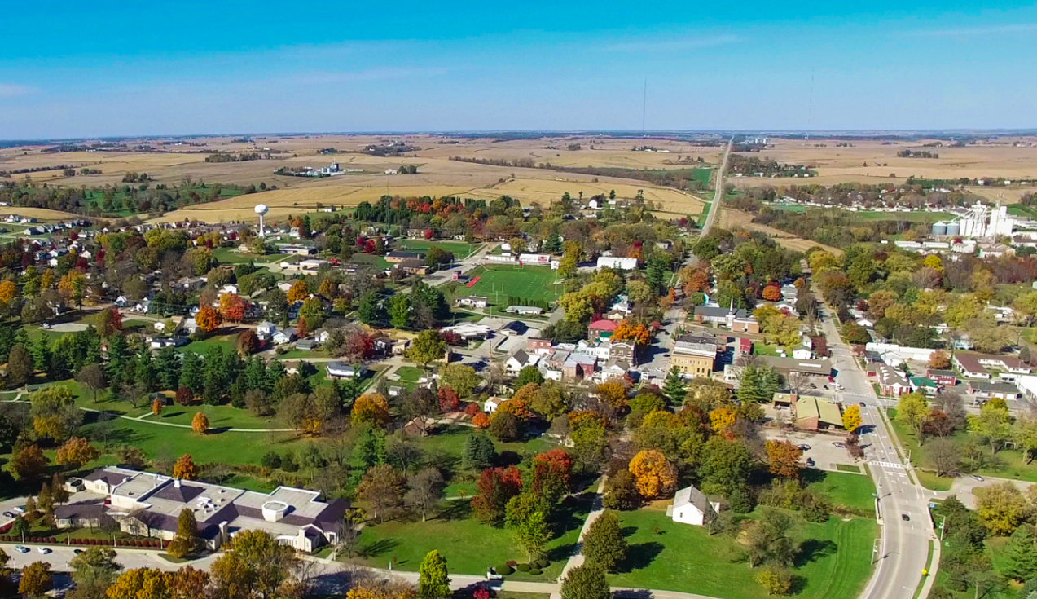
West Branch
Capital Improvement Plan & Fiscal Policies
Spring Presentation

Slide 2


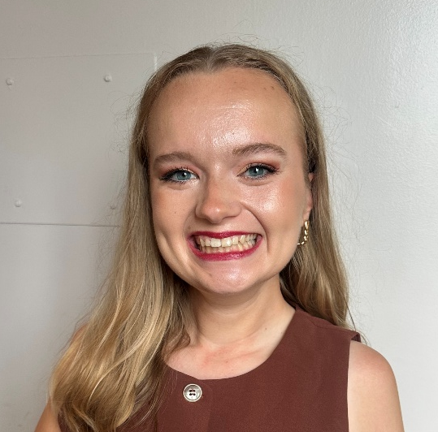
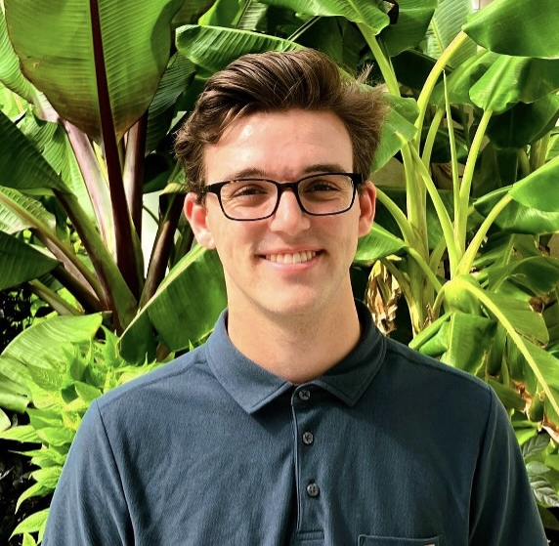
Fiscal Policy & Capital Improvement Plan Team
Fern Bultema
Yihan Li
Allie Tubbs
Erik Woolsey
Faculty Advisors:
Travis Kraus & Phuong Nguyen
Community Partners:
Adam Kofoed & Heidi Van Auken

Slide 3
Purpose Statement
This Capital Improvement Plan and Fiscal Policies will create a multi-year, strategic framework to prepare for future growth and position the City of West Branch for long-term prosperity.

Slide 4
West Branch
Capital Improvement Plan (FY 2028- 2032)
4

Slide 5
Capital Improvement Plan Needs & Deliverable
Need
Deliverable
New five-year plan
Long-term infrastructure planning
More opportunities for community feedback
FY 2028 – 2032 Plan
Repeatable process for project identification & evaluation
Goals
Transparency, Resident Feedback, & Project Viability

Slide 6
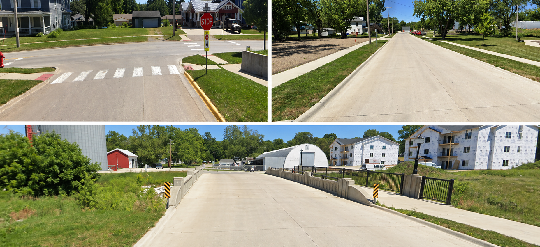
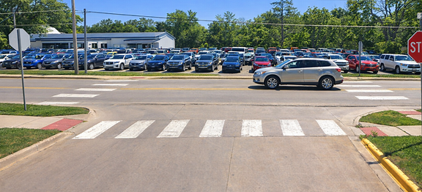
Capital Improvement Plan 2015 - 2020
9 of 19
Projects Completed

Slide 7
Best Practice Research
Ranked Grading
City of Ely, IA
Resident Engagement
City of Urbandale, IA
Evaluation Criteria
City of Brentwood, MO

Slide 8
FY 2028 – 2032 CIP Process
Review Committee Applications
Department Interviews
Project Proposals
Select Residents
Review Committee Meeting #1
Review Committee Meeting #2
CIP Resident Survey
Compare Scores & Financials

Slide 9
Project Proposals by Committee Ranking
Water Plant
Beranek Park
Thomas Drive Sewer
Main Street Super Project
Sewer Televising
Greenview Water Main
Herbert Hoover Trail
Main Street Water Main
Rail Trail
Splash Pad
Town Hall
Truck Re-Route
North Downey Water Main
Ladder Truck
New Police/Fire Station
Community Center
Pedestrian Bridge
300 Street Renovation
New Library
South Baker/Downey Overlay
Cemetery Plots
Infrastructure
Amenities
Roads

Slide 10
Recommended Projects by Committee Ranking
Water Plant
Beranek Park
Thomas Drive Sewer
Main Street Super Project
Sewer Televising
Greenview Water Main
Herbert Hoover Trail
Main Street Water Main
Rail Trail
Splash Pad
Town Hall
Truck Re-Route
North Downey Water Main
Ladder Truck
New Police/Fire Station
Community Center
Pedestrian Bridge
300 Street Renovation
New Library
South Baker/Downey Overlay
Cemetery Plots
Infrastructure
Amenities
Roads

Slide 11
Recommended Projects
FY 2028
FY 2029-2030
FY 2031
FY 2032

Slide 12

Map of Recommended Project

Slide 13
FY 28 Recommendations

Slide 14
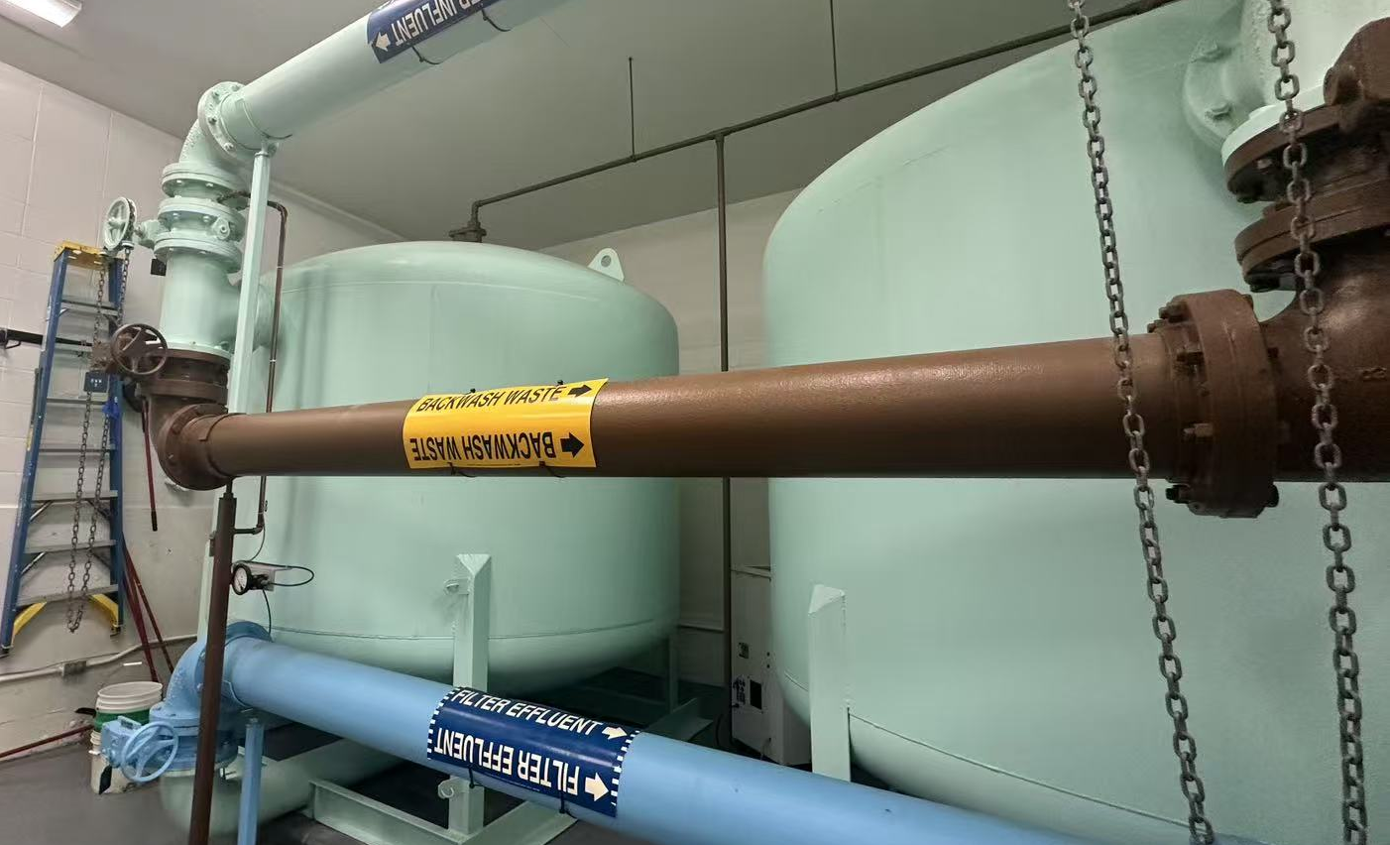
FY 2028 Recommendations
Water Plant
Committee Rank: 1
Cost: $3,000,000
Funding from:
State Revolving Fund Water Loan

Slide 15
FY 2028 Recommendations – Highway Trail
Herbert Hoover Highway Trail
Committee Rank: 7
Cost: $300,000
Funding from:
Local Option Sales Tax (LOST)
Grants

Slide 16
FY29 – 30 Recommendations

Slide 17
FY 2029-2030 Recommendations
Truck Re-Route
Committee Rank: 12
Cost: $550,000 - $1,000,000
Funding from:
General Obligation Bond
Potential Grants

Slide 18
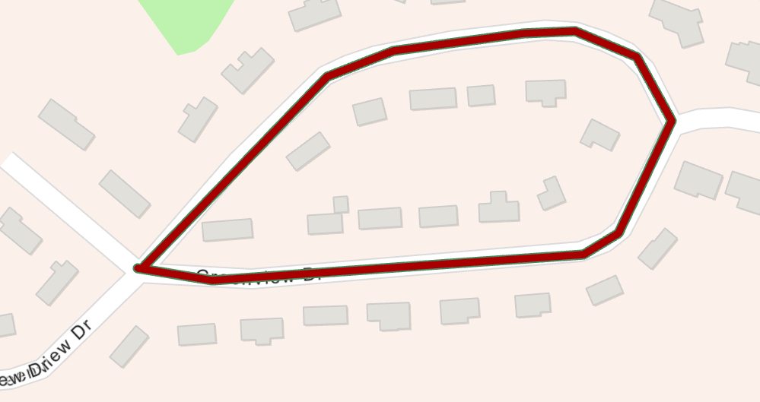
FY 2029-2030 Recommendations – Greenview Water Main
Greenview Water Main
Committee Rank: 6
Cost: $360,000
Funding from:
General Obligation Bond
Potential Grants

Slide 19
FY 2029-2030 Recommendations – N Downey Water Main
North Downey
Water Main
Committee Rank: 13
Cost: $250,000
Funding from:
General Obligation Bond
Potential Grants

Slide 20
FY 2029-2030 Recommendations – Thomas Drive Sewer
Thomas Drive
Sewer Main
Committee Rank: 3
Cost: $1,370,000
Funding from:
General Obligation Bond
Potential Grants

Slide 21
FY 31 Recommendations

Slide 22
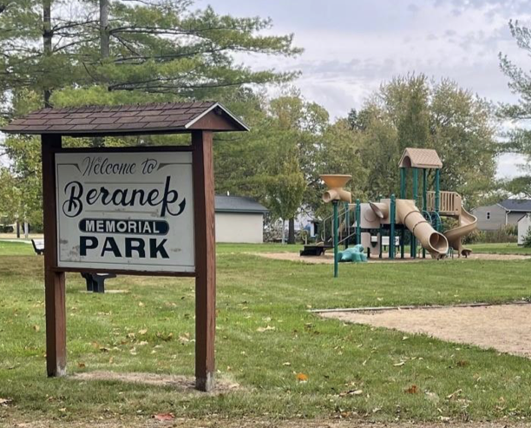
FY 2031 Recommendations
Beranek Park
Committee Rank: 2
Cost: $300,000-$350,000
Funding from:
LOST Fund
Private Fundraising
Potential Grants

Slide 23
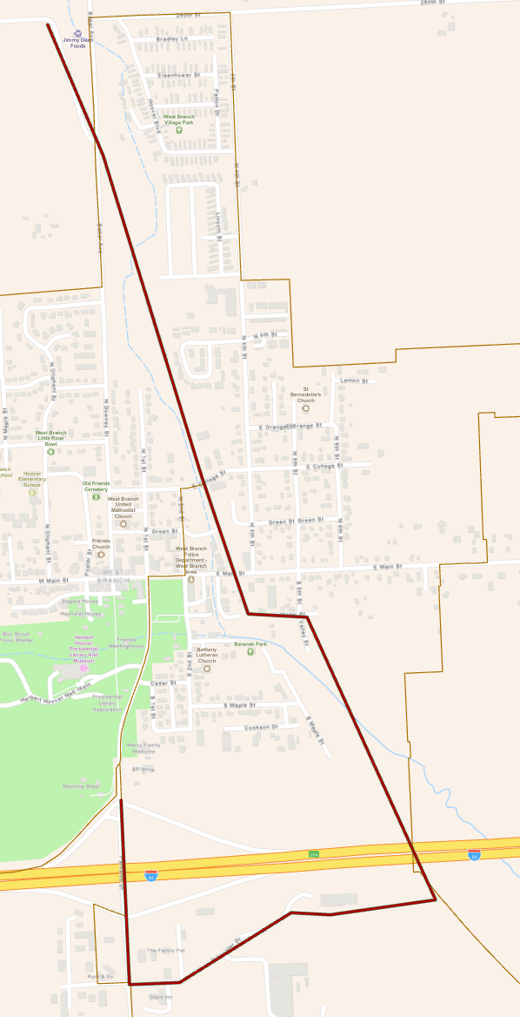
FY 2031 Recommendations – Rail Trail
Rail Trail
Committee Rank: 9
Cost: $90,000
Funding from:
LOST Fund
Potential Grants

Slide 24
FY 2031 Recommendations – sewer Televising
Sewer Televising
Sewer Televising
Committee Rank: 5
Cost: $110,000
Funding from:
Sewer Fund
Sewer Televising
Committee Rank: 6
Funding from:
Sewer Fund

Slide 25
FY32 Recommendations

Slide 26
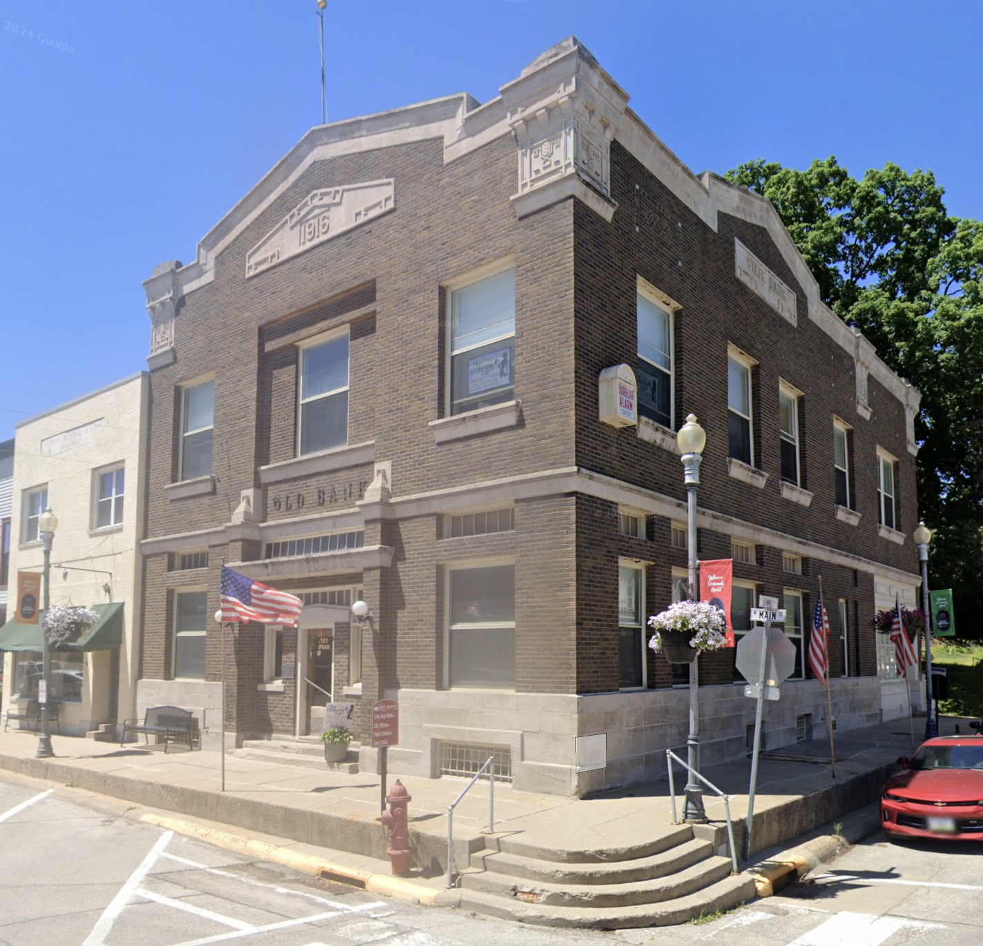
FY 2032 Recommendations
Main Street Phase 1
Committee Rank: 4
Cost: $2,500,000
Funding from:
General Obligation Bond
Potential Grants

Slide 27
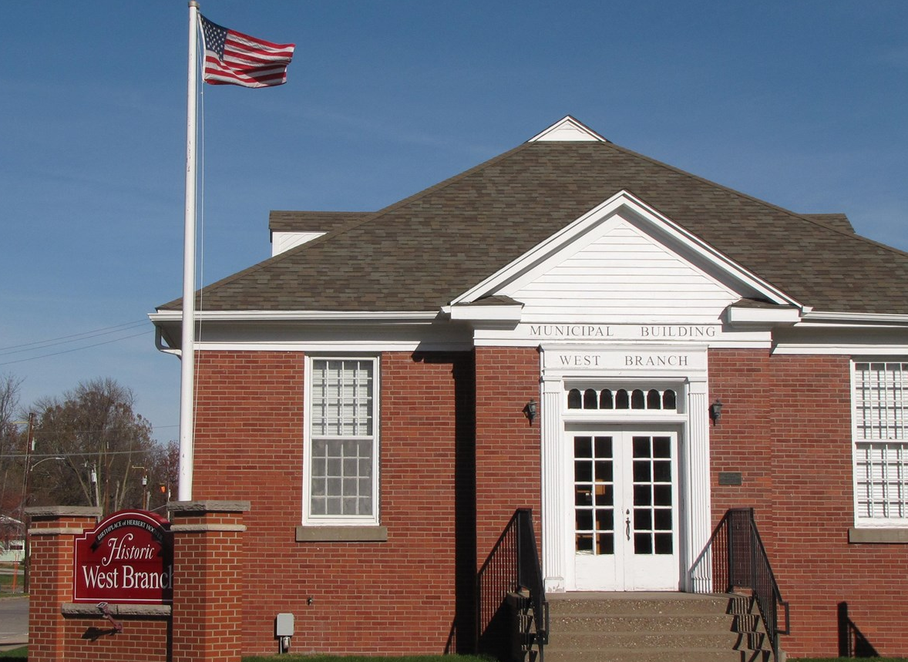
FY 2032 Recommendations – Town Hall
Town Hall
Committee Rank: 11
Cost: $50,000
Funding from:
Town Hall Fund
Potential Grants

Slide 28
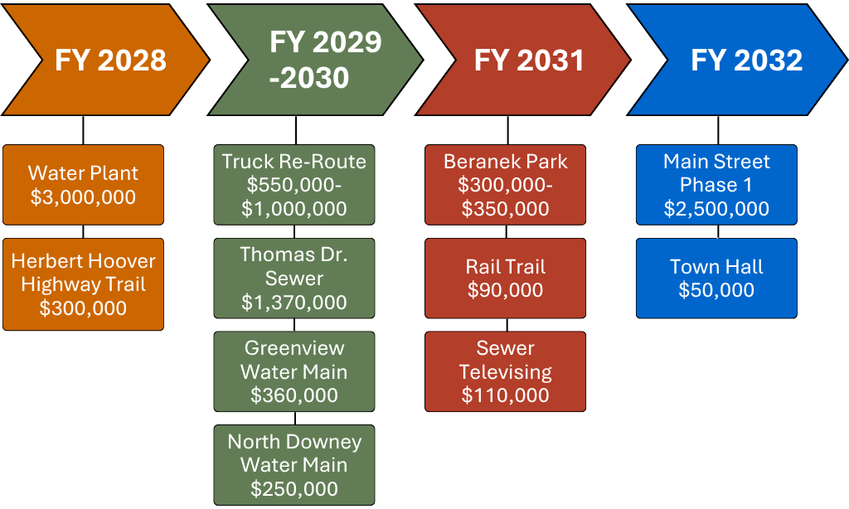
FY 2028 -2032 CIP Recommendations
Total: $8,800,000 - $9,380,000

Slide 29
West Branch
Fiscal Policies

Slide 30
Fiscal Policy Needs & Deliverable
Need
Deliverable
Consistent policy formatting
Increased transparency
Equitable allocation of funds
Clear administrative process for Tax Increment Financing projects
Updated General Fiscal Policies
Application & Policies for Tax Increment Financing
Goals
Increased Transparency & Accountability, Comprehensive Policy Coverage, Maximize Efficiency of Taxpayer Dollars

Slide 31
Fiscal Policy Process
Case Study Fiscal Policy Research
Gap Analysis to Identify Missing Policies
First Draft of New Practices & Policies
City Staff Feedback
Finalize Fiscal Policies
Faculty Feedback
Implement Edits
City Staff / Review

Slide 32
Tax Increment Financing Application
TIF Policies
TIF Procedure
TIF Application
TIF Eligibility
Crafted by West Branch
General Information
‘But – For’ Condition
TIF Committee Initial Application Screening
Utility Requirements
Project Timeline
City Council Votes
Benefits to West Branch Community
Utility Requirements
Pro Forma

Slide 33
Fiscal Policy Recommendations
Policy Chapter | Recommended Policy Changes | Total Policy Sections in Chapter
Fiscal Management Policy | 2 New, 2 Revised | 16 Sections
Debt Management Policy | 5 New, 1 Revised | 6 Sections
Purchasing Policy | 4 New, 0 Revised | 5 Sections
Investment Policy | 0 New, 8 Revised | 12 Sections

Slide 34
Fiscal Policy Spotlight: Fiscal Management
Policy Name | Revised/New | Section Summary
Accounting, Auditing and Financial Reporting | Revised | Mandates the city must have: A financial plan Annual financial reporting Annual CIP budgets and Independent auditing
Cash Reserve Policies | Revised | Mandates what Cash Reserves in specific funds may be used for
Donation Acceptance | New | Provides guidelines on how donations should be managed
Surplus Terms of Sale | New | Provides guidelines on how surplus items from city departments should be handled and sold Includes Asset Inventory policy

Slide 35
Fiscal Policy Spotlight: Fiscal Management (highlighted)
Fiscal Policy Spotlight: Fiscal Management
Policy Name | Revised/New | Section Summary
Accounting, Auditing and Financial Reporting | Revised | Mandates the city must have: A financial plan Annual financial reporting Annual CIP budgets and Independent auditing
Cash Reserve Policies | Revised | Mandates what Cash Reserves in specific funds may be used for
Donation Acceptance | New | Provides guidelines on how donations should be managed
Surplus Terms of Sale | New | Provides guidelines on how surplus items from city departments should be handled and sold Includes Asset Inventory policy

Slide 36
Fiscal Policy Spotlight: Debt Management
Policy Name | Revised/New | Section Summary
Debt Purpose | New | Determines what projects debt may be incurred to fund
Debt Procedure | New | Covers what sort of debt or bonds should be preferred by the City
Debt Administration | Revised | Provides guidelines on how debt should be managed How much debt the City can incur, as a percentage of assessed value How much of property tax levy can be put towards debt service
Advance Refundings | New | Repayment of debt before total debt term
Arbitrage Compliance | New | Fiscal record keeping policy
City’s Debt / Credit Rating | New | Covers where the City can borrow from

Slide 37
Fiscal Policy Spotlight: Debt Management (Highlighted)
Fiscal Policy Spotlight: Debt Management
Policy Name | Revised/New | Section Summary
Debt Purpose | New | Determines what projects debt may be incurred to fund
Debt Procedure | New | Covers what sort of debt or bonds should be preferred by the City
Debt Administration | Revised | Provides guidelines on how debt should be managed How much debt the City can incur, as a percentage of assessed value How much of property tax levy can be put towards debt service
Advance Refundings | New | Repayment of debt before total debt term
Arbitrage Compliance | New | Fiscal record keeping policy
City’s Debt / Credit Rating | New | Covers where the City can borrow from

Slide 38
Fiscal Policy Spotlight: Purchasing Policy
Policy Name | Revised/New | Section Summary
Contract Bidding | New | Process for how the City receives and handles bids on public projects
Competitive Quotation Process | New | Covers quotes for public projects when cost is less than contract bidding threshold
Contract Administration | Revised | Guidelines on how public contracts should be administered, when contract re-negotiation is necessary
Emergency Repairs | New | Provides guidance on what the City may contract during a period of emergency.

Slide 39
Fiscal Policy Spotlight: Purchasing Policy (highlighted)
Fiscal Policy Spotlight: Purchasing Policy
Policy Name | Revised/New | Section Summary
Contract Bidding | New | Process for how the City receives and handles bids on public projects
Competitive Quotation Process | New | Covers quotes for public projects when cost is less than contract bidding threshold
Contract Administration | Revised | Guidelines on how public contracts should be administered, when contract re-negotiation is necessary
Emergency Repairs | New | Provides guidance on what the City may contract during a period of emergency.

Slide 40
Fiscal Policy Spotlight: Investment Policy
Policy Name | Revised/New | Section Summary
Scope of Investment Policy | Revised | Updated wording to stay consistent with Iowa state code
Objectives of Investment Policy | Revised | Provides further clarification on specific goals for return on investment
Prudence | Revised | New guidelines on what prudence means in terms of public investment
Instruments Eligible for Investment | Revised | Specific list of investments that are safe enough for public funds
Investment Maturity Limitations | Revised | Covers investment of operating funds that are not immediately required for expenses
Safekeeping and Custody | Revised | Updated wording to stay consistent with Iowa state code
Ethics and Conflicts of Interest | Revised | Expanded policy to specify what actions public employees should take in case of conflicts of interest
Reporting | Revised | Updated policy to match West Branch’s current practices

Slide 41
Fiscal Policy Spotlight: Investment Policy (highlighted)
Fiscal Policy Spotlight: Investment Policy
Policy Name | Revised/New | Section Summary
Scope of Investment Policy | Revised | Updated wording to stay consistent with Iowa state code
Objectives of Investment Policy | Revised | Provides further clarification on specific goals for return on investment
Prudence | Revised | New guidelines on what prudence means in terms of public investment
Instruments Eligible for Investment | Revised | Specific list of investments that are safe enough for public funds
Investment Maturity Limitations | Revised | Covers investment of operating funds that are not immediately required for expenses
Safekeeping and Custody | Revised | Updated wording to stay consistent with Iowa state code
Ethics and Conflicts of Interest | Revised | Expanded policy to specify what actions public employees should take in case of conflicts of interest
Reporting | Revised | Updated policy to match West Branch’s current practices

Slide 42
West Branch
Next Steps

Slide 43
Adoption Process
Fiscal
Policies
Financial Advisor Reviews
City Council Approves
Review as Needed
Capital Improvement Plan
City Council Approves
Public
Hearing
Annual Review

Slide 44
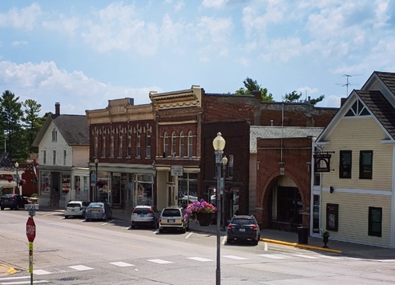
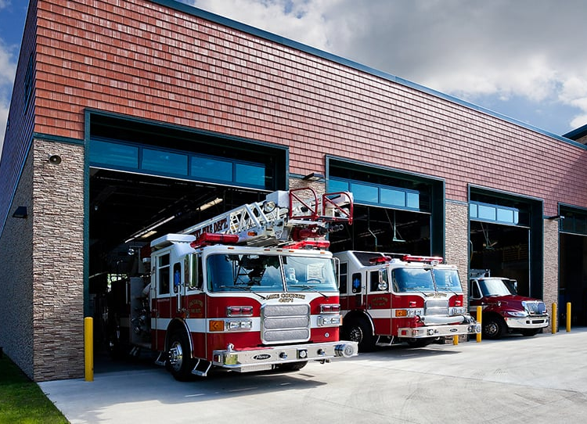
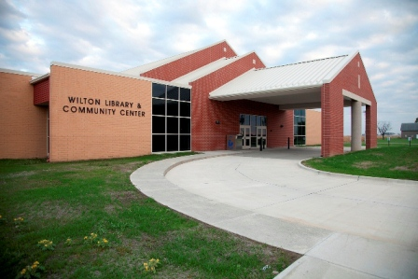
Beyond Our Project
Remaining Main Street Phases
Police & Fire Station
Community Center
+ Library

Slide 45
Questions?
Key Takeaways:
        New 12-step CIP planning process
    11 projects recommended for FY 2028 – 2032 CIP
    11 new and 11 revised fiscal policy subsections
    New TIF application and 17 policies

Slide 46
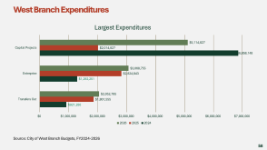
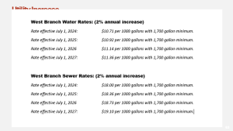
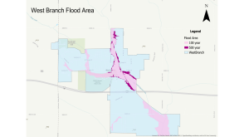
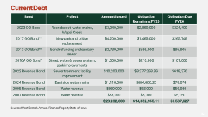
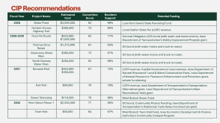
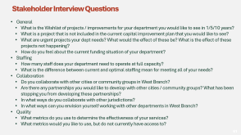
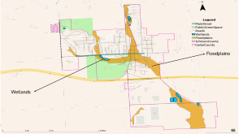
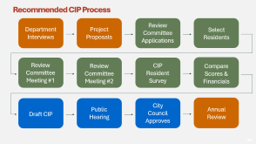
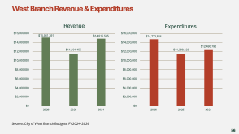
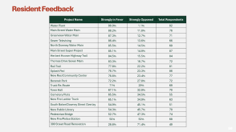
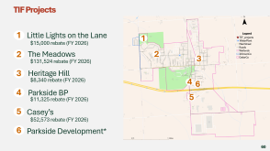
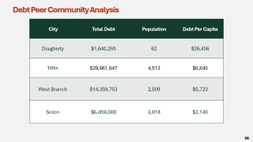
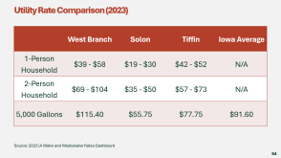
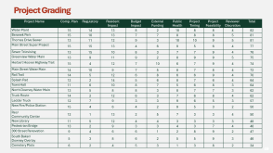
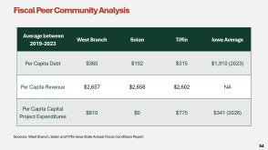
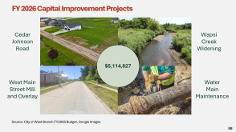
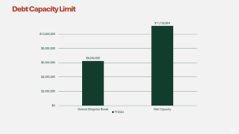
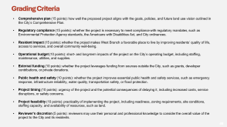
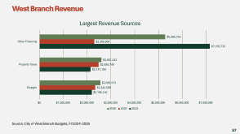
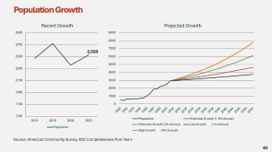
Questions

Slide 47
CIP Recommendations
Fiscal Year | Project Name | Estimated Cost | Committee Score | Resident Support | Potential Funding
2028 | Water Plant | $3,000,000 | 82 | 99% | Loan from Iowa’s State Revolving Fund
 | Herbert Hoover Highway Trail | $300,000 | 74 | 85% | Local Option Sales Tax (LOST) revenue
2029-2030 | Truck Re-Route | $550,000-$1,000,000 | 62 | 71% | General Obligation (GO) bond (with water and sewer mains), Iowa Department of Transportation’s Safety Improvement Program grant
 | Thomas Drive Sewer | $1,370,000 | 81 | 83% | GO bond (with water mains and truck re-route)
 | Greenview Water Main | $360,000 | 75 | 87% | GO bond (with sewer mains and truck re-route)
 | North Downey Water Main | $250,000 | 62 | 86% | GO bond (with sewer mains and truck re-route)
2031 | Beranek Park | $300,000-$350,000 | 81 | 72% | LOST revenue, Capital Improvement Levy reserves, Iowa Department of Natural Resources’ Land & Water Conservation Fund, Iowa Department of Natural Resources’ Resource Enhancement and Protection grant, private fundraising
 | Rail Trail | $90,000 | 70 | 78% | LOST revenue, Iowa Department of Transportation’s Transportation Alternatives grant, Iowa Department of Transportation’s State Recreational Trails grant
 | Sewer Televising | $110,000 | 76 | 86% | West Branch Sewer Fund
2032 | Main Street Phase 1 | $2,500,000 | 77 | 85% | GO bond, Community Project Funding, Iowa Department of Transportation’s Pedestrian Curb Ramp Construction grant
 | Town Hall | $50,000 | 64 | 67% | West Branch Town Hall Fund, Iowa Economic Development & Finance Authority’s Community Catalyst Program

Slide 48
Grading Criteria
Comprehensive plan (15 points): how well the proposed project aligns with the goals, policies, and future land use vision outlined in the City’s Comprehensive Plan.
Regulatory compliance (15 points): whether the project is necessary to meet compliance with regulatory mandates, such as Environmental Protection Agency standards, the Americans with Disabilities Act, and City ordinances.
Resident impact (15 points): whether the project makes West Branch a favorable place to live by improving residents’ quality of life, access to services, and overall community well-being.
Operational budget (10 points): short- and long-term impacts of the project on the City’s operating budget, including staffing, maintenance, utilities, and supplies.
External funding (10 points): whether the project leverages funding from sources outside the City, such as grants, developer contributions, or private donations.
Public health and safety (10 points): whether the project improves essential public health and safety services, such as emergency response, infrastructure reliability, water quality, transportation safety, or flood protection.
Project timing (10 points): urgency of the project and the potential consequences of delaying it, including increased costs, service disruptions, or safety concerns.
Project feasibility (10 points): practicality of implementing the project, including readiness, zoning requirements, site conditions, staffing capacity, and availability of resources, such as land.
Reviewer’s discretion (5 points): reviewers may use their personal and professional knowledge to consider the overall value of the project to the City and its residents.

Slide 49
Project Grading
Project Name | Comp. Plan | Regulatory | Resident Impact | Budget Impact | External Funding | Public Health | Project Timing | Project Feasibility | Reviewer Discretion | Total
Water Plant | 15 | 14 | 13 | 8 | 2 | 10 | 8 | 8 | 4 | 82
Beranek Park | 15 | 10 | 13 | 7 | 7 | 8 | 8 | 8 | 5 | 81
Thomas Drive Sewer | 13 | 11 | 12 | 9 | 3 | 10 | 10 | 9 | 5 | 81
Main Street Super Project | 15 | 15 | 13 | 4 | 6 | 9 | 5 | 6 | 4 | 77
Sewer Televising | 13 | 15 | 10 | 8 | 3 | 7 | 7 | 9 | 4 | 76
Greenview Water Main | 13 | 9 | 11 | 9 | 2 | 8 | 9 | 9 | 5 | 75
Herbert Hoover Highway Trail | 15 | 4 | 12 | 7 | 10 | 6 | 7 | 9 | 4 | 74
Main Street Water Main | 14 | 10 | 9 | 7 | 5 | 8 | 7 | 8 | 4 | 72
Rail Trail | 14 | 5 | 12 | 6 | 8 | 6 | 6 | 9 | 4 | 70
Splash Pad | 12 | 2 | 14 | 5 | 6 | 8 | 7 | 6 | 4 | 64
Town Hall | 11 | 6 | 10 | 8 | 7 | 5 | 6 | 8 | 3 | 64
North Downey Water Main | 13 | 5 | 8 | 8 | 3 | 8 | 7 | 7 | 3 | 62
Truck Route | 14 | 2 | 12 | 6 | 3 | 7 | 6 | 8 | 4 | 62
Ladder Truck | 12 | 7 | 9 | 3 | 3 | 9 | 6 | 5 | 3 | 57
New Fire/Police Station | 15 | 4 | 6 | 4 | 2 | 9 | 5 | 3 | 2 | 50
Rec/ Community Center | 12 | 1 | 13 | 2 | 5 | 7 | 3 | 3 | 4 | 50
New Library | 11 | 5 | 12 | 4 | 4 | 3 | 3 | 3 | 3 | 48
Pedestrian Bridge | 13 | 2 | 9 | 3 | 3 | 4 | 3 | 7 | 4 | 48
300 Street Renovation | 9 | 4 | 6 | 6 | 1 | 2 | 8 | 9 | 2 | 47
South Baker/ Downey Overlay | 5 | 3 | 8 | 6 | 2 | 5 | 5 | 9 | 3 | 46
Cemetery Plots | 6 | 2 | 4 | 5 | 3 | 1 | 3 | 8 | 2 | 34

Slide 50
Resident Feedback
Project Name | Strongly in Favor | Strongly Opposed | Total Respondents
Water Plant | 98.9% | 1.1% | 92
Main Street Water Main | 88.2% | 11.8% | 76
Greenview Water Main | 87.3% | 12.7% | 71
Sewer Televising | 86.4% | 13.6% | 66
North Downey Water Main | 85.5% | 14.5% | 69
Main Street Super Project | 85.1% | 14.9% | 87
Herbert Hoover Highway Trail | 84.5% | 15.5% | 84
Thomas Drive Sewer Main | 83.3% | 16.7% | 72
Rail Trail | 77.8% | 22.2% | 81
Splash Pad | 76.7% | 23.3% | 86
New Rec/Community Center | 76.6% | 23.4% | 77
Beranek Park | 72.2% | 27.8% | 72
Truck Re-Route | 71% | 29% | 69
Town Hall | 67.1% | 32.9% | 70
Cemetery Plots | 65.5% | 34.5% | 55
New Fire Ladder Truck | 65.1% | 34.9% | 63
South Baker/Downey Street Overlay | 54.9% | 45.1% | 51
New Public Library | 54.3% | 45.7% | 70
Pedestrian Bridge | 52.7% | 47.3% | 74
New Fire/Police Station | 50% | 50% | 68
300 Street Road Renovation | 28.6% | 71.4% | 49

Slide 51
Recommended CIP Process
Review Committee Applications
Department Interviews
Project Proposals
Select Residents
Review Committee Meeting #1
Review Committee Meeting #2
CIP Resident Survey
Compare Scores & Financials
City Council Approves
Public Hearing
Annual Review
Draft CIP

Slide 52
Current Debt
Bond | Project | Amount Issued | Obligation Remaining FY25 | Obligation Due FY26
2023 GO Bond | Roundabout, water mains, Wapsi Creek | $3,040,000 | $2,860,000 | $324,400
2017 GO Bond** | New park and bridge replacement | $4,200,000 | $1,465,000 | $265,748
2013 GO Bond** | Bond refunding and sanitary sewer | $2,730,000 | $595,000 | $95,905
2016A GO Bond* | Street, water & sewer system, park improvements | $1,000,000 | $210,000 | $101,000
2022 Revenue Bond | Sewer treatment facility improvement | $10,203,000 | $8,277,268.86 | $618,370
2024 Revenue Bond | East side water mains | $1,116,000 | $884,686.25 | $70,074
2005 Revenue Bond | Water revenue | $860,000 | $56,000 | $56,980
2007 Revenue Bond | Water revenue | $83,000 | $5,000 | $5,150
 |  | $23,232,000 | $14,352,955.11 | $1,537,627
Source: West Branch Annual Finance Report, State of Iowa
Notes:
* Means this debt will be paid off by 2028
** means this debt will be paid off by 2032

Slide 53
Debt Capacity Limit

Slide 54
Fiscal Peer Community Analysis
Average between 2019-2023 | West Branch | Solon | Tiffin | Iowa Average
Per Capita Debt | $360 | $192 | $315 | $1,910 (2023)
Per Capita Revenue | $2,657 | $2,658 | $2,602 | NA
Per Capita Capital Project Expenditures | $810 | $0 | $775 | $341 (2026)
Sources: West Branch, Solon and Tiffin Iowa State Annual Fiscal Conditions Report

Slide 55
Debt Peer Community Analysis
City | Total Debt | Population | Debt Per Capita
Dougherty | $1,640,295 | 62 | $26,456
Tiffin | $29,961,647 | 4,512 | $6,640
West Branch | $14,359,753 | 2,509 | $5,723
Solon | $6,459,000 | 3,018 | $2,140

Slide 56
West Branch Revenue & Expenditures
Source: City of West Branch Budgets, FY2024-2026
Notes:
31% increase in revenue, 29% increase in expenditures
1.6% increase in revenue, 18% increase in expenditures
“Van Auken explained the differences in from the FY25 and FY26 budget where many of the changes are due to inflation, increased utility costs, fire department salaries, building inspections, and special projects such as a new comprehensive plan, use of LMI funds, cost associated with the city election in November, resurfacing the roadways in the municipal cemetery and additional TIF rebate payments.”

Slide 57
West Branch Revenue
Source: City of West Branch Budgets, FY2024-2026
Notes:
Property taxes (fy26) – decreased property tax right in FY 26 (per 100k decreased $24)
Property taxes (fy25) – increased in FY 25 to pay for public safety employees
CP for 2024 – roundabouts, WW Fac, I80 utility moving (move water pipeline), water mains

Slide 58
West Branch Expenditures
Source: City of West Branch Budgets, FY2024-2026
Notes:
Property taxes (fy26) – decreased property tax right in FY 26 (per 100k decreased $24)
Property taxes (fy25) – increased in FY 25 to pay for public safety employees
CP for 2024 – roundabouts, WW Fac, I80 utility moving (move water pipeline), water mains

Slide 59
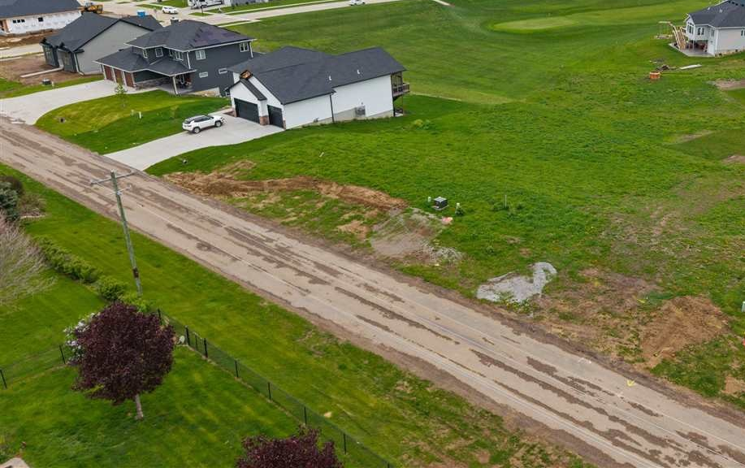
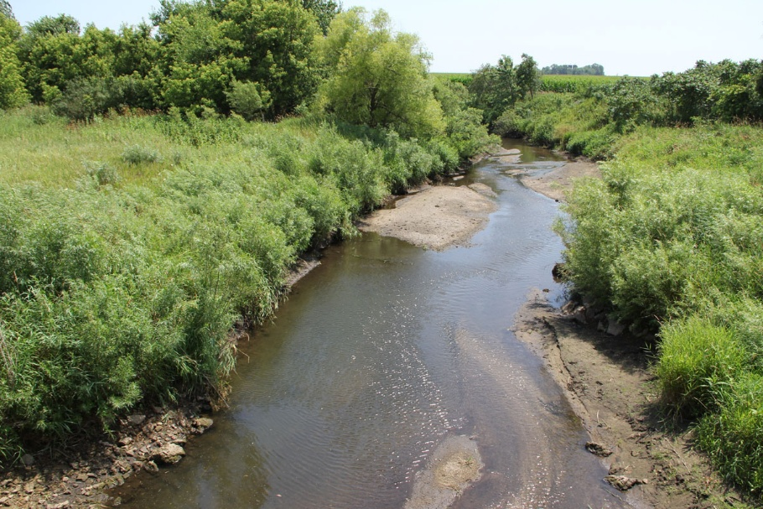
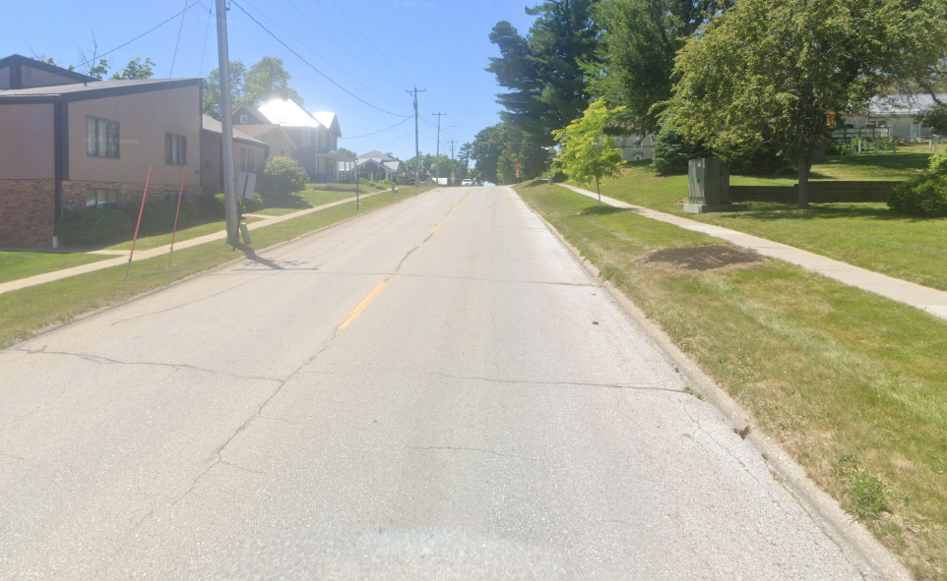
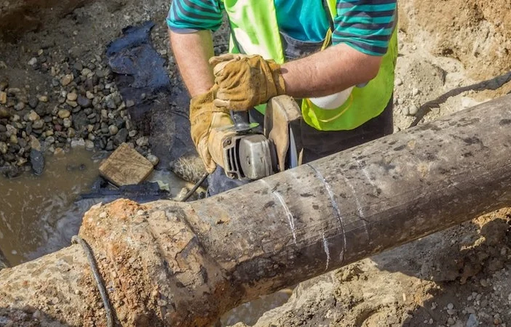
FY 2026 Capital Improvement Projects
Cedar Johnson Road
Wapsi Creek Widening
$5,114,827
West Main Street Mill and Overlay
Water
Main Maintenance
Source: City of West Branch FY2026 Budget, Google Images
Notes:
35% of expenditures

Slide 60
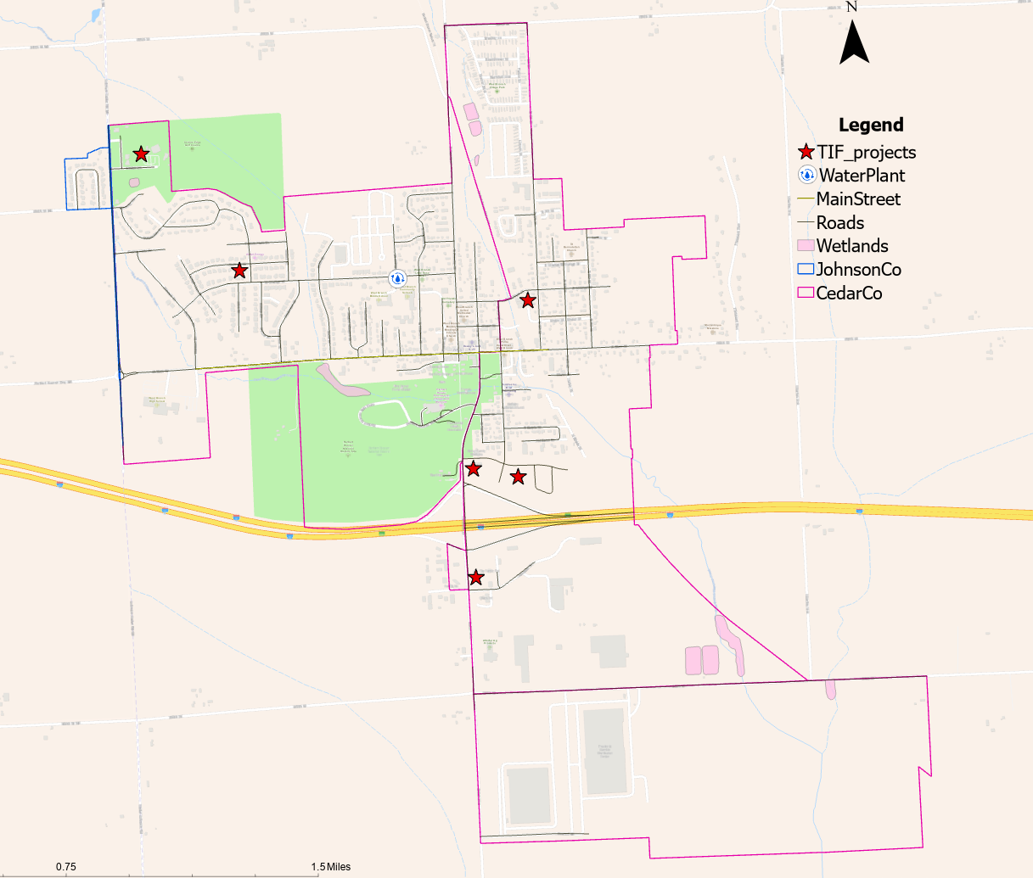
TIF Projects
1
Little Lights on the Lane
1
1
$15,000 rebate (FY 2026)
2
The Meadows
2
2
3
3
$131,524 rebate (FY 2026)
3
Heritage Hill
$8,340 rebate (FY 2026)
4
4
6
6
4
Parkside BP
5
$11,325 rebate (FY 2026)
5
5
Casey’s
$52,573 rebate (FY 2026)
6
Parkside Development*

Slide 61
Stakeholder Interview Questions
General
What is the Wishlist of projects / improvements for your department you would like to see in 1/5/10 years?
What is a project that is not included in the current capital improvement plan that you would like to see?
What are urgent projects your dept needs? What would the effect of these be? What is the effect of these projects not happening?
How do you feel about the current funding situation of your department?
Staffing
How many staff does your department need to operate at full capacity?
What is the difference between current and optimal staffing mean for meeting all of your needs?
Collaboration
Do you collaborate with other cities or community groups in West Branch?
Are there any partnerships you would like to develop with other cities / community groups? What has been stopping you from developing these partnerships?
In what ways do you collaborate with other jurisdictions?
In what ways can you envision yourself working with other departments in West Branch?
Quality
What metrics do you use to determine the effectiveness of your services?
What metrics would you like to use, but do not currently have access to?

Slide 62
Population Growth
2,526
Source: American Community Survey, IISC Comprehensive Plan Team

Slide 63
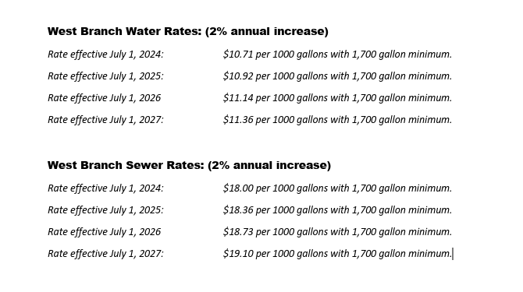
Utility Increase

Slide 64
Utility Rate Comparison (2023)
 | West Branch | Solon | Tiffin | Iowa Average
1-Person Household | $39 - $58 | $19 - $30 | $42 - $52 | N/A
2-Person Household | $69 - $104 | $35 - $50 | $57 - $73 | N/A
5,000 Gallons | $115.40 | $55.75 | $77.75 | $91.60
Source: 2023 IA Water and Wastewater Rates Dashboard

Slide 65
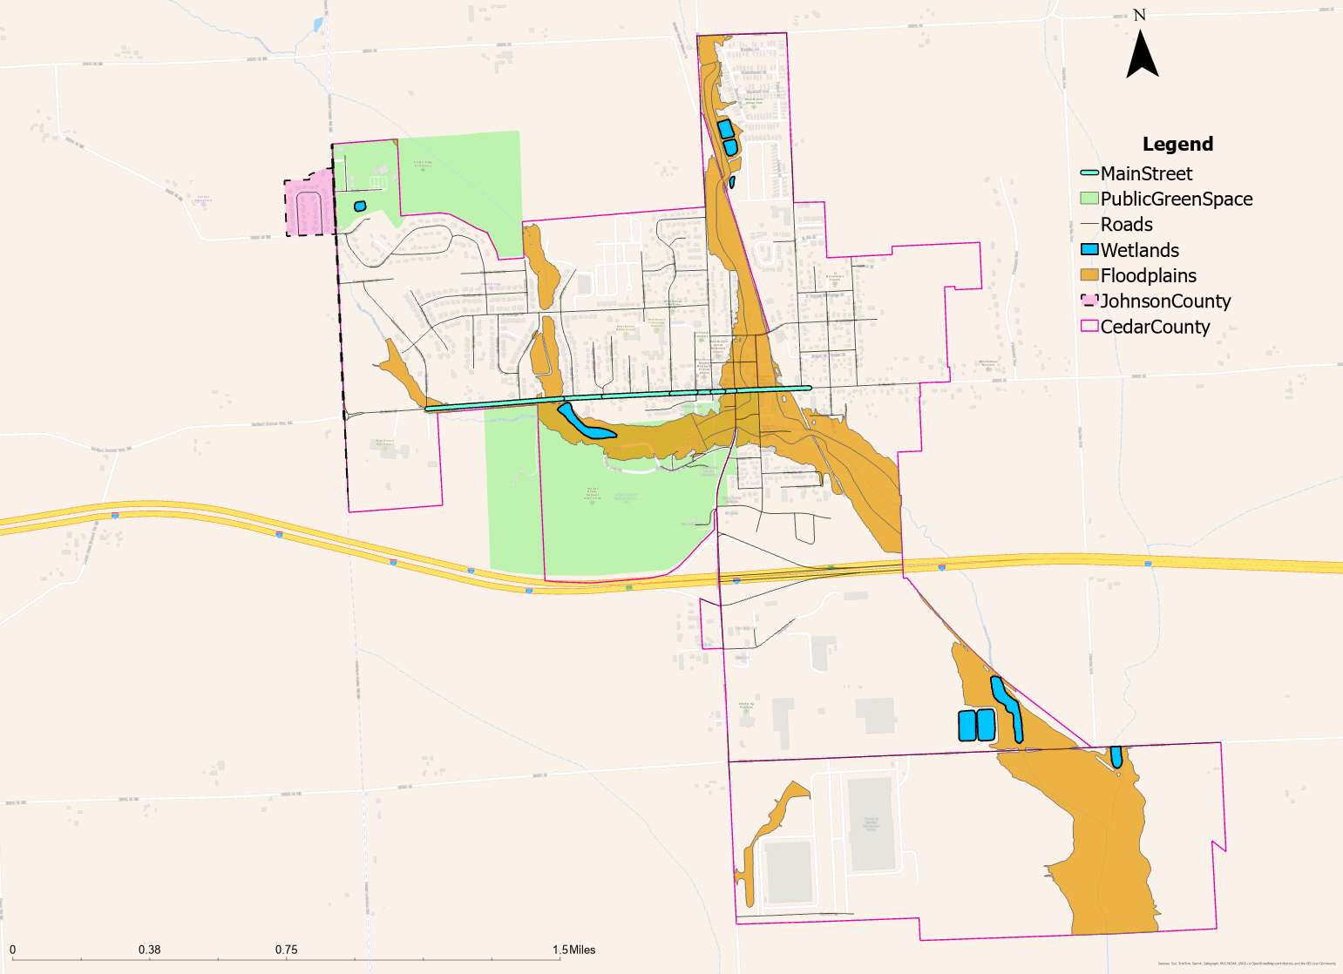
Map of West Branch
Floodplains
Wetlands

Slide 66
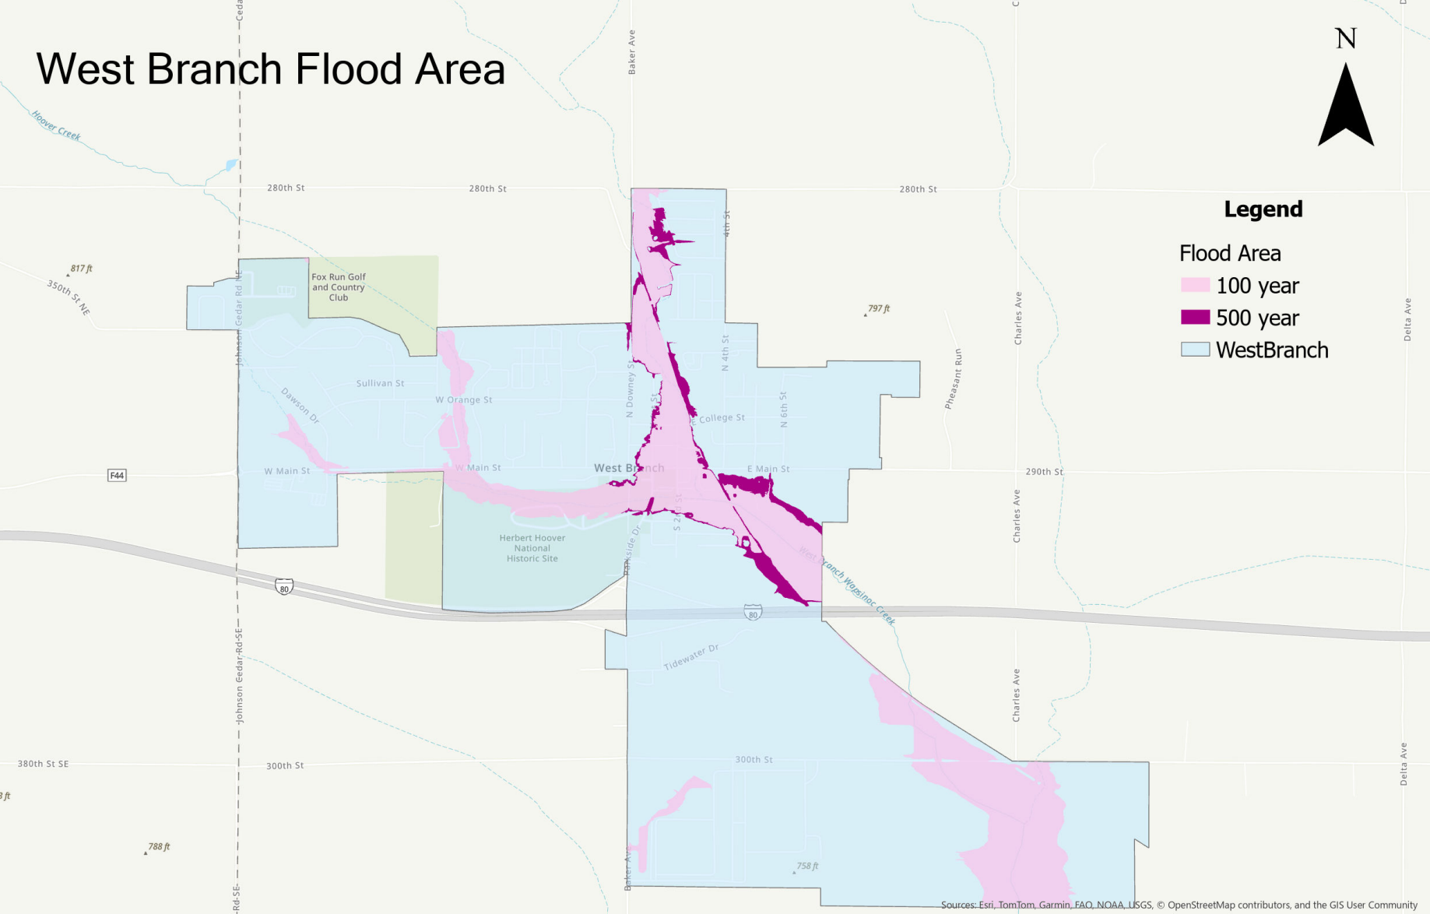
West Branch Flood Area

